Slide 1


Canon
Professional Print
Essential Business Builder Program
Helping deliver
business success
you can
1

Slide 2

LEAP
with Canon
Canon can help you make the LEAP into new digital print services or take steps to enhance your business performance and production processes.
Notes:
2

Slide 3



Status of merger of Canon and Océ
  16 Nov 2009 –
  Canon announces intention to
  acquire Océ
  May 2010 –
  Canon Majority shareholder: approximately 90% of Océ
  ordinary shares
  Integration Steering Committee formed with executives from
  both companies
  Canon and Océ aim to create the
  global leader in the printing industry

Slide 4
Customers
Integration will focus on benefit
to customers of Canon and Océ
Positive reaction from
our customers
Hardware and software heritage and expertise of Canon and Océ
Combination of Canon and Océ technologies is already proven in customer sites
Already launched joint products imagePRESS C7010VPS

Slide 5

Long-term relationships drive profit
Developing our Professional Print Business since 2005
Canon focus is on helping our customers to grow
and develop their business through long-term relationships
Kyosei:
Living and working together for the common good

Slide 6
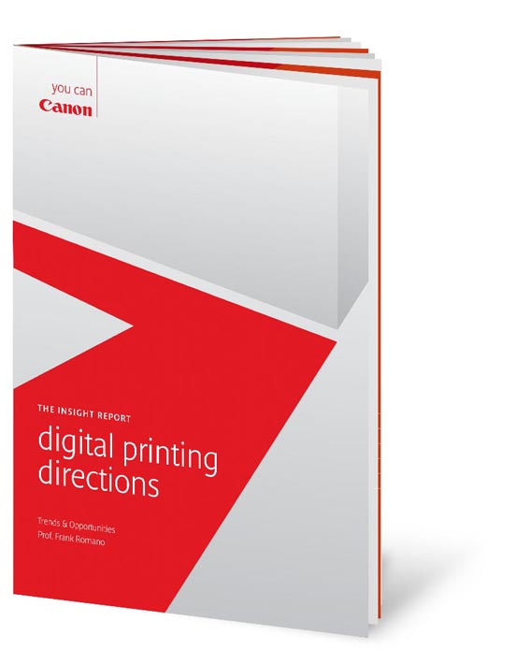
2008
Digital printing directions
Offset revenues will decline significantly by 2020
Nearly 90% of businesses see
costs rising faster than revenue
72% believe they can’t continue
to do things the same way
70% believe biggest revenue growth is during next 5 years is digital colour
87% look for business development help from current suppliers
The small (digital only) print service provider will undergo a ‘renaissance’
Notes:
forward.

Slide 7

2009
CRD trends & opportunities
A CRD is there to save money over outsourcing and can save up to 30%
But 65% of them save less than
10% or don’t know
More work is coming back in
house and it is now 50 / 50
When web to print is used, customer satisfaction increases
85% want to add new services

Slide 8
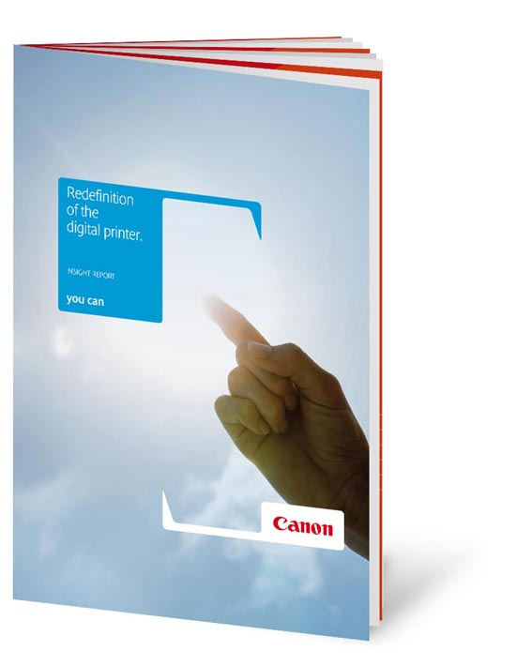
2010
Redefinition of the digital printer
Notes:
8

Slide 9
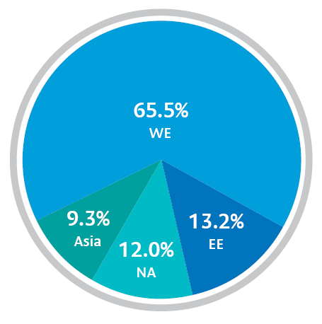
Report methodology
840
interviews
65.5%
in Western Europe
15%
start-ups, most of
them digital only
40%
had digital capability
Of the 2008 interviewees:
11%
merged
6%
out of business
Notes:
9

Slide 10


Decline in run lengths; huge increase in short runs, especially in jobs less than 2000 run length
Digital capability increased
revenue / profit
Significant growth in
digital print technologies
Digital printing
saved us
Service providers with
digital printing
Service providers without digital printing
2008-2009
50
20
Offset
Litho
Toner
Inkjet
40
Who had decreased
revenue and / or profits
Who increased
revenue and / or profits
Decreased revenue
and / or profits
15
30
10
11.7%
% of jobs less than 2000 run length
5
20
31.7%
0
41.4%
58.3%
30.0%
% of revenue
10
-5
26.9%
-10
Flat revenue
and / or profits
0
Increased revenue
and / or profits
Who had flat revenue and /or profits
2007
2008
2009
Notes:
10

Slide 11

Leap
New production processes
New markets
New business models
New opportunities
New revenue streams

Slide 12

Our approach
Establishing your challenges and opportunities in
a structured way
DISCOVER
RECOMMEND
IMPLEMENT
SUPPORT
REVIEW

Slide 13

Key EBBP Elements
GA
CRD

Slide 14

Canon Workflow Program
Input
Process
Output
Information Management
Customer Proposition
Adding
Value
Increasing Versatility
Market Focus
Graphic
Arts
Central Reprographic Departments
Colour Management
Growing
Volume
VDP
Photo Print Services
(photo books)
Cross Media
Software & Services
Web to Print

Slide 15

DISCOVER DIGITAL
HARDWARE
Raise
Canons extensive range
of digital production devices offers high
quality output with flexibility of production.
your levels of productivity,
flexibility and innovation
Notes:
15

Slide 16
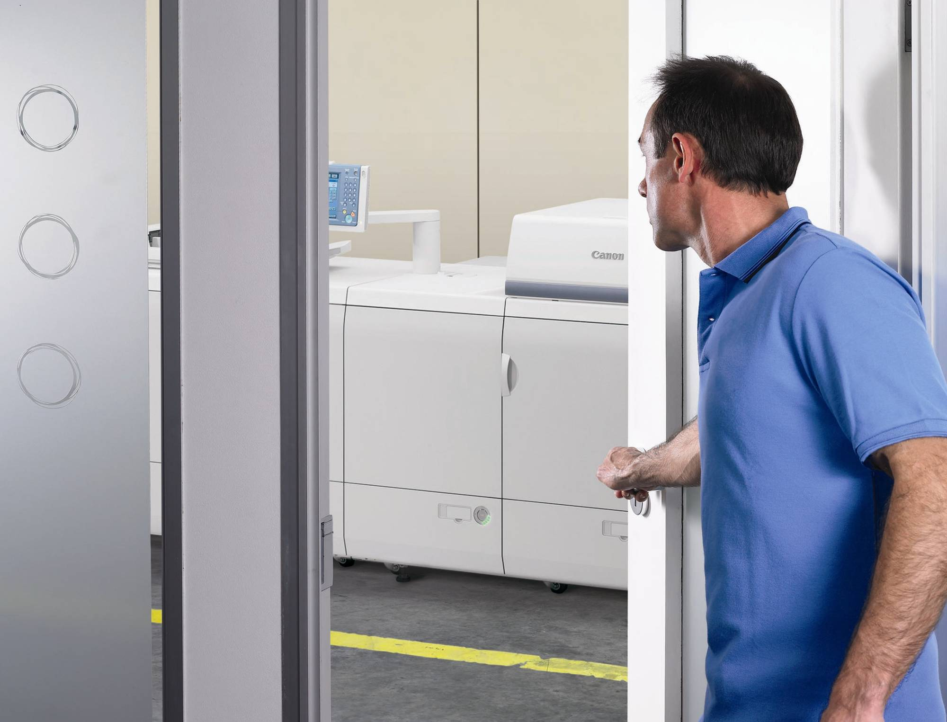
A digital device to
suit your business requirements.
imagePRESS
colour range
imageRUNNER ADVANCE PRO colour range
VarioPrint 6000 Ultra Line Black and White range
imagePRESS
Black&White range
imageRUNNER ADVANCE
Black&White range

Slide 17

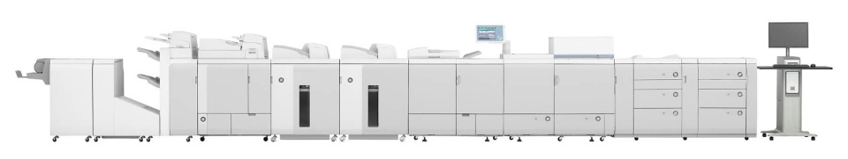
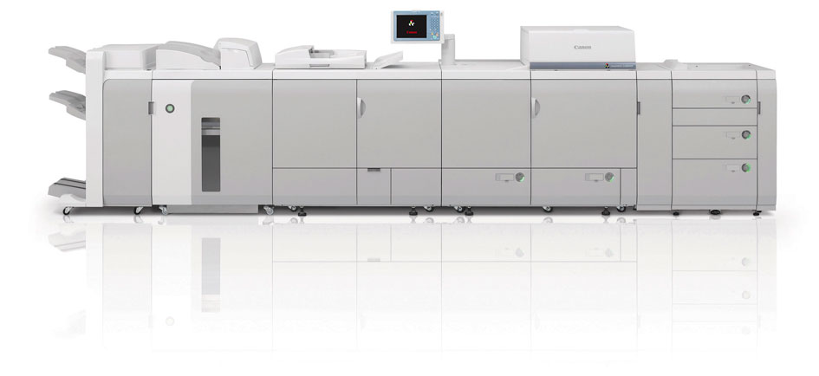
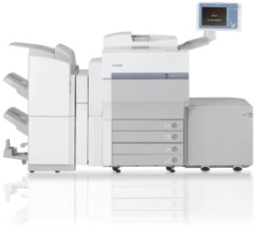
imagePRESS colour range
imagePRESS C7010VP
imagePRESS C6010VP
imagePRESS C6010
imagePRESS C1+
Notes:
17

Slide 18
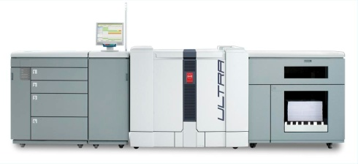
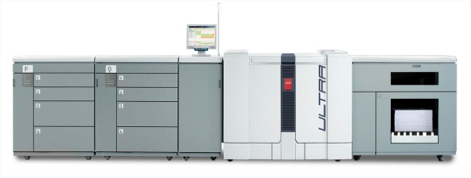
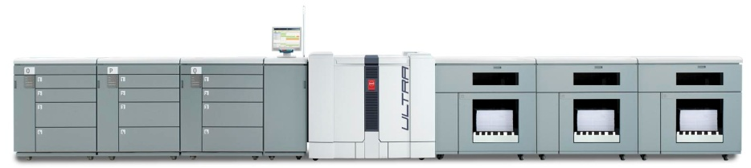
VarioPrint 6000 Ultra Line Black and White range
VarioPrint 6160 Ultra
VarioPrint 6200 Ultra
VarioPrint 6250 Ultra
VarioPrint 6320 Ultra
Return to Graphic Arts range Menu
Continue to next range
Notes:
18

Slide 19
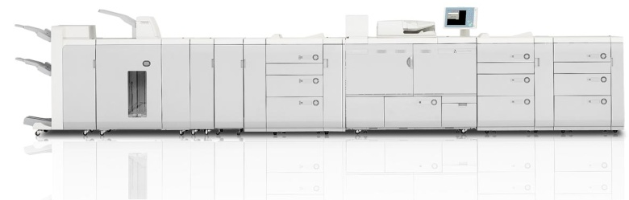
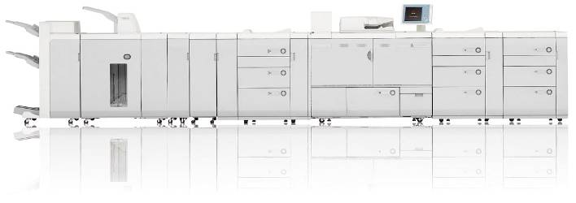
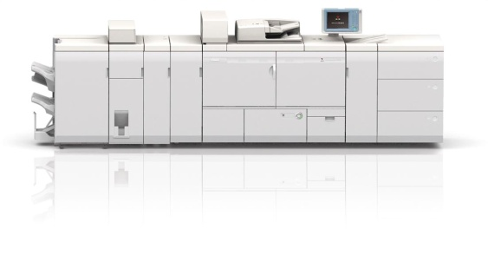
imagePRESS Black& White range
imagePRESS 1135
imagePRESS 1125
imagePRESS 1110
Return to Graphic Arts range Menu
Continue to next range
Notes:
19

Slide 20



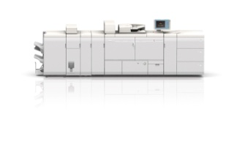

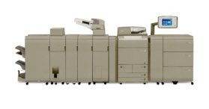
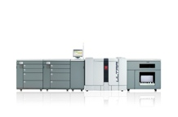
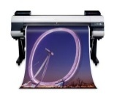
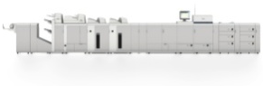
Extensive portfolio
Expertise across the entire printing spectrum
Océ VarioPrint®
6000 Ultra Series
B&W
imagePRESS 1135
imagePRESS 1125
imagePRESS 1110
Colour
imagePRESS C7010VPS
imagePRESS C6010VPS
imagePRESS C6010S
imagePRESS C7010VP
imagePRESS C6010VP
imagePRESS C6010
imagePRESS C1+
B&W
imageRUNNER
ADVANCE 8105
imageRUNNER
ADVANCE 8095
imageRUNNER
ADVANCE 8085
Colour
imageRUNNER ADVANCE C9070 Pro
imageRUNNER
ADVANCE C9060 Pro
B&W/Colour
VarioPrint
6320 Ultra
VarioPrint
6250 Ultra
VarioPrint
6200 Ultra
VarioPrint
6160 Ultra
Colour
imagePROGRAF iPF6300
imagePROGRAF iPF910

Slide 21
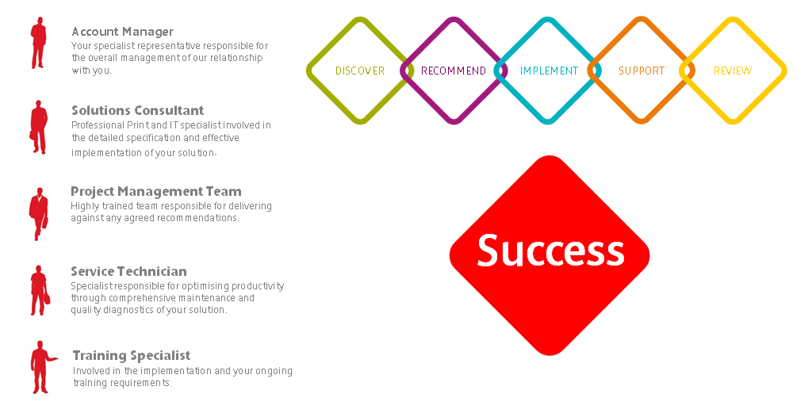
Structured support at every step

Slide 22


