Slide 1
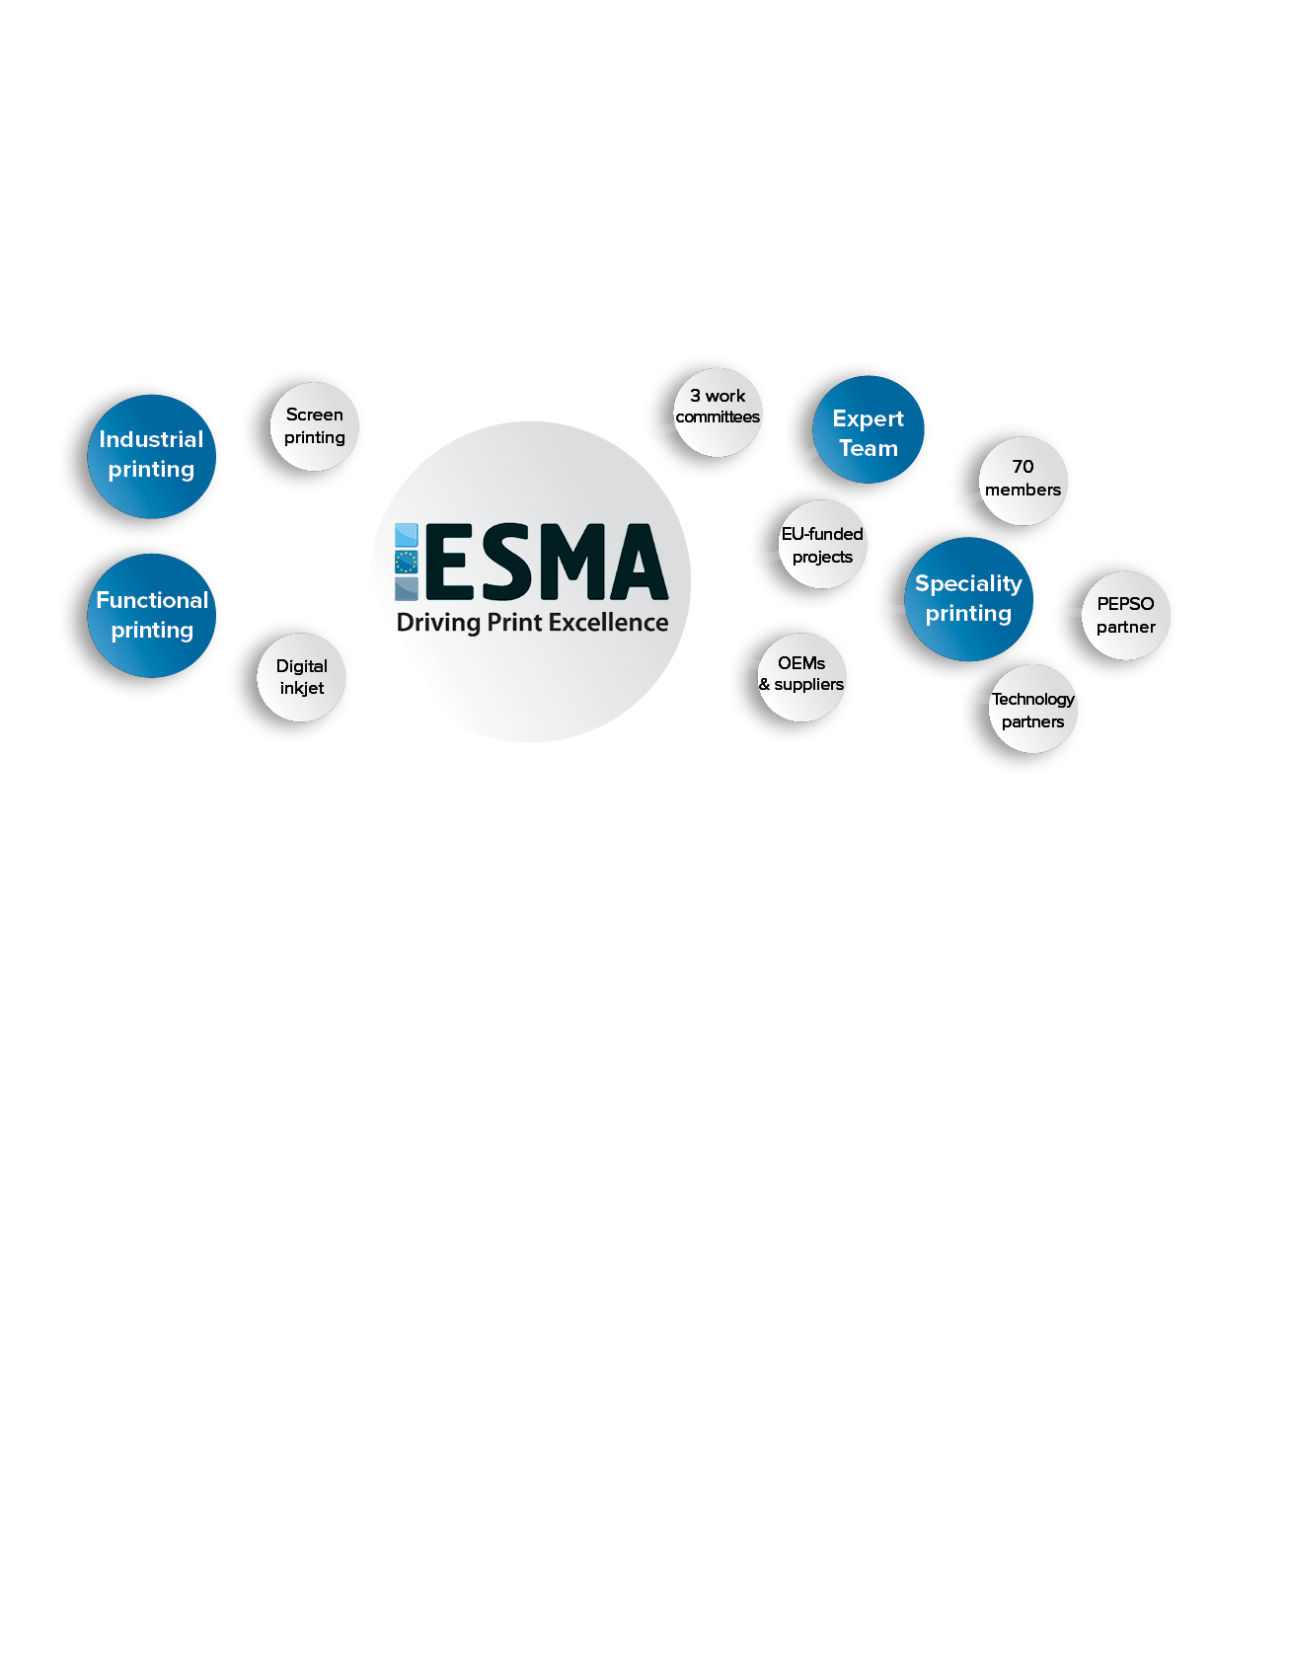
Industrial printing: growth market
Breakthrough of industrial inkjet printing
Peter Buttiens
9 March 2017

Slide 2
Overview
ESMA introduction
The world of Industrial Printing
What is industrial printing
Road map of Industrial Inkjet
Market statistical summary
Inkjet technology
Industrial Printing segmentation
Samples of modern industrial printing
Décor & laminates: new frontier
Low migration requirements
Conclusions
ESMA conferences

Slide 3
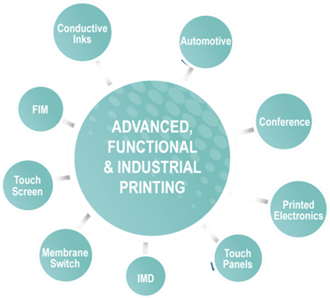
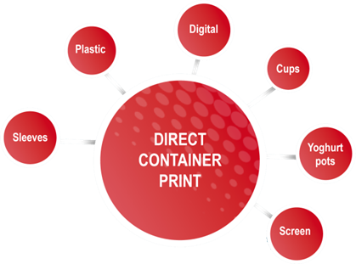
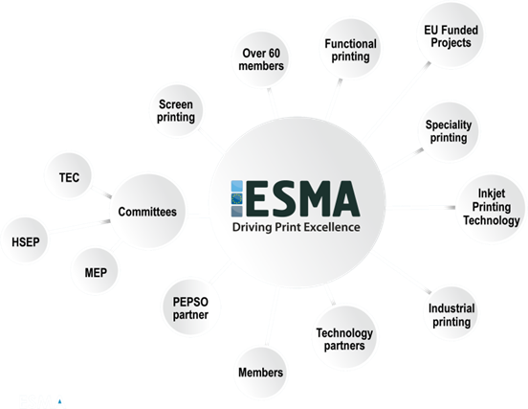
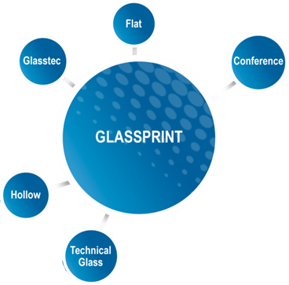
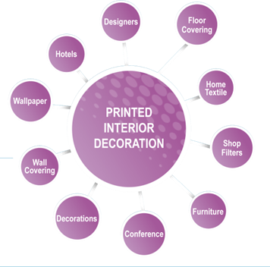
ESMA: Connecting the dots IN the industry
/20

Slide 4
What is industrial printing?
What?
Print as a process (= manufacturing step) and not really print as a product (like a banner)
Can be high volume and low cost (label) or low volume and high cost (watch face)
Who?
Industrial printing is predominantly done by specialised service partners
Why?
Industrial printing is optimising production (time, cost and possibilities)
Industrial inkjet offers new possibilites of mass customisation (= online orders)
What Uber is for taxi, what Netflix is for watching TV, what AirBnB is for accomodation
In printing, inkjet is bring this also peronsalised in all sizes, quantities…
cfr: Cimpress (=VistaPrint, Pixartprinting…)
/20

Slide 5
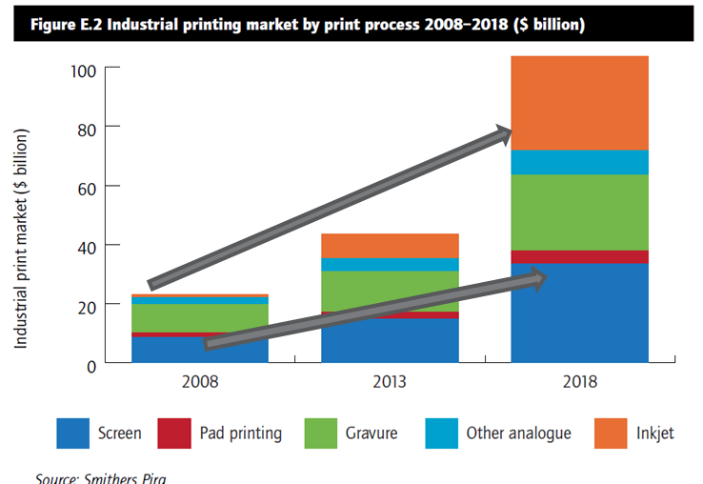
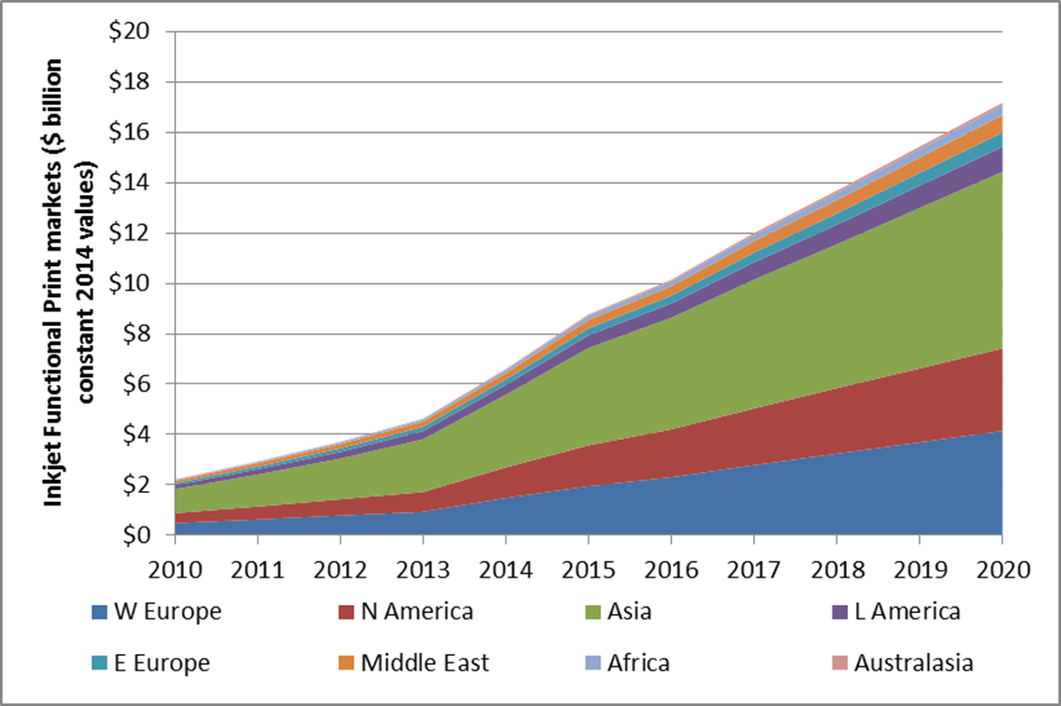
The world of industrial printing
Impact of inkjet on functional printing
/20

Slide 6
The road map of inkjet
SATURATION
IN
GRAPHICS
In the last 10 years
Super
wide format
In the early nineties
In the late nineties
Large format
Wide format
Flat-bed
printing
/20

Slide 7
The road map of inkjet and jump to industrial
First commercial success >5y
Corrugated
cardboard
Ceramic
tiles
Packaging
Low Migration
Glass
Single
pass
Direct
to
shape
Labels
Plastic
Last 2-4 years
Wallpaper
Textile
printing
Decor &
Flooring
/20

Slide 8
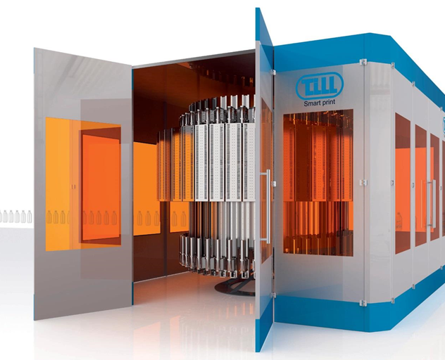
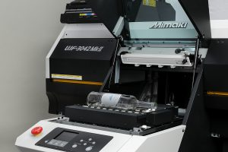
The road map of inkjet and jump to industrial
Till Tech modulare digital inkjet printer
Mimaki with option for bottles
Around 30 pieces per hour
Around 450 pieces per hour (full colour + 2 spot colours)

Slide 9
Market Statistical Summary
Wide Format Aqueous R2R | 2015 | 2016 | 2017 | 2018 | 2019 | 2020 | CAGR 15-20
Installed units | 38 438 | 37 669 | 37 292 | 36 919 | 36550 | 36016 | -1%
Ink revenue in millions USD | 900 | 803 | 706 | 603 | 752 | 604 | -8%
Wide Format Solvents R2R + Latex/Eco | 2015 | 2016 | 2017 | 2018 | 2019 | 2020 | CAGR 15-20
installed units | 29 623 | 30 800 | 32 026 | 32 662 | 33 312 | 34 457 | 3%
ink revenue in millions USD | 1 493 | 1 497 | 1 567 | 1 491 | 1 714 | 1 683 | 2%
Wide Format UV R2R & Flabed | 2015 | 2016 | 2017 | 2018 | 2019 | 2020 | CAGR 15-20
installed units | 3 016 | 3 113 | 3 200 | 3 249 | 3 300 | 3 387 | 2%
ink revenue in millions USD | 376 | 384 | 397 | 388 | 433 | 431 | 3%
Prime Labels | 2015 | 2016 | 2017 | 2018 | 2019 | 2020 | CAGR 15-20
installed units | 323 | 410 | 506 | 656 | 658 | 740 | 18%
ink revenue in millions USD | 105 | 150 | 209 | 275 | 316 | 375 | 29%
/20
Source: I.T. Strategies, March 2016, Digital Industrial, Communications, Graphics Print & High Volume Inkjet

Slide 10
Market Statistical Summary
Packaging, coding and graphics | 2015 | 2016 | 2017 | 2018 | 2019 | 2020 | CAGR 15-20
installed units | 75 | 125 | 200 | 300 | 400 | 468 | 44%
ink revenue in millions USD | 1.08 | 2.19 | 4.17 | 488 | 740 | 836 | extreme
Production R2R textiles | 2015 | 2016 | 2017 | 2018 | 2019 | 2020 | CAGR 15-20
installed units | 578 | 682 | 765 | 887 | 984 | 1 088 | 13%
ink revenue in millions USD | 232 | 297 | 372 | 457 | 454 | 543 | 19%
Dye Sub R2R | 2015 | 2016 | 2017 | 2018 | 2019 | 2020 | CAGR 15-20
installed units | 9 472 | 9 920 | 10 388 | 10 879 | 11 316 | 11 789 | 4%
ink revenue in millions USD | 268 | 271 | 274 | 277 | 309 | 306 | 3%
Ceramics | 2015 | 2016 | 2017 | 2018 | 2019 | 2020 | CAGR 15-20
installed units | 1 300 | 1 200 | 1 100 | 750 | 550 | 395 | -21%
ink revenue in millions USD | 1 615 | 1 731 | 1 814 | 1 868 | 2 030 | 2 101 | 5%
/20
Source: I.T. Strategies, March 2016, Digital Industrial, Communications, Graphics Print & High Volume Inkjet

Slide 11
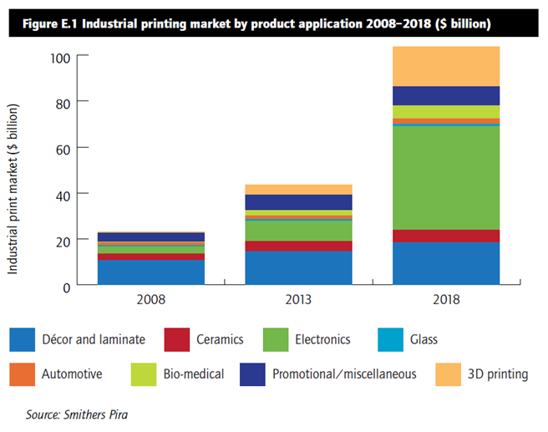
The world of industrial printing
Leading segments:
Electronics
Décor & Laminate
3D printing
Promotional/misc
Bio-Medical
/20

Slide 12
Inkjet technology
What is special?
Widely used print process
Growing market adoption
New opportunities and functionality
Flexible process
Non contact
Any shape, size
Low cost set up
Precision and speed
Combination with
other print processes
/20
Youtube: https://youtu.be/m5m3se-KQZg

Slide 13
Main segmentations for industrial inkjet
/20

Slide 14
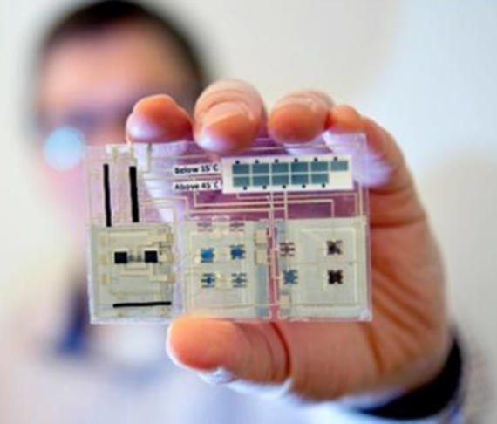
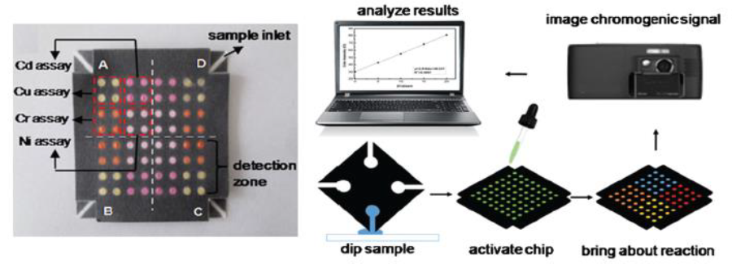
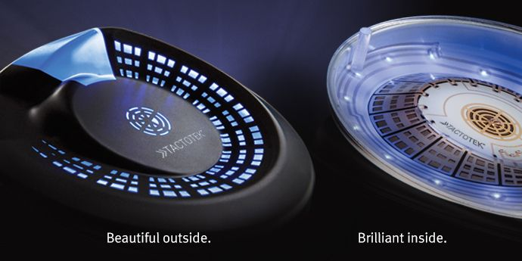
Samples of industrial printing
Printed Electronics
Bio-medicals & Printed electronics & Microfluids
Smart labels/packaging + IoT
In-mold electronics: https://youtu.be/QDuc0YLFbds
/20

Slide 15
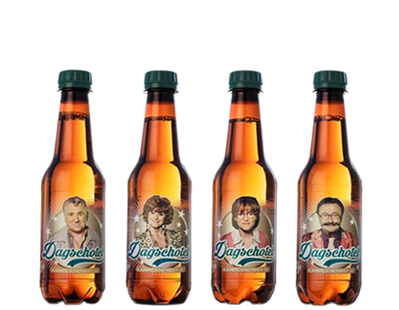
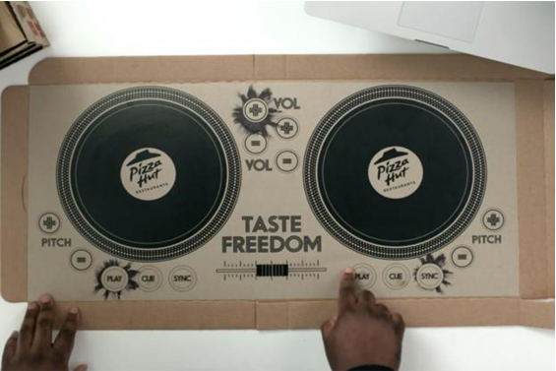
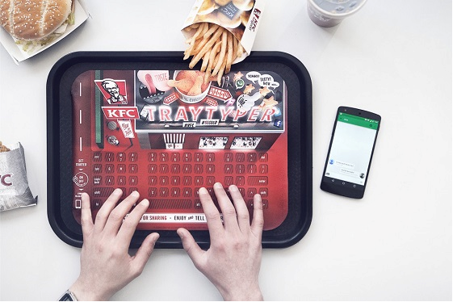
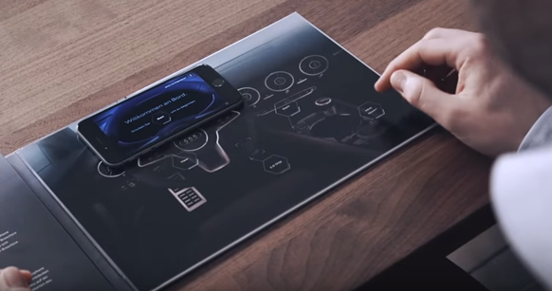
Videos of inspirational projects for brands
DJ set in a pizza box by Pizza Hut
Wireless keyboard by KFC
https://youtu.be/7H7RkIzNCJs
https://youtu.be/1xVepNA60tM
Audi TT brochure Hack
https://youtu.be/qzJ9InscjA0
/20

Slide 16
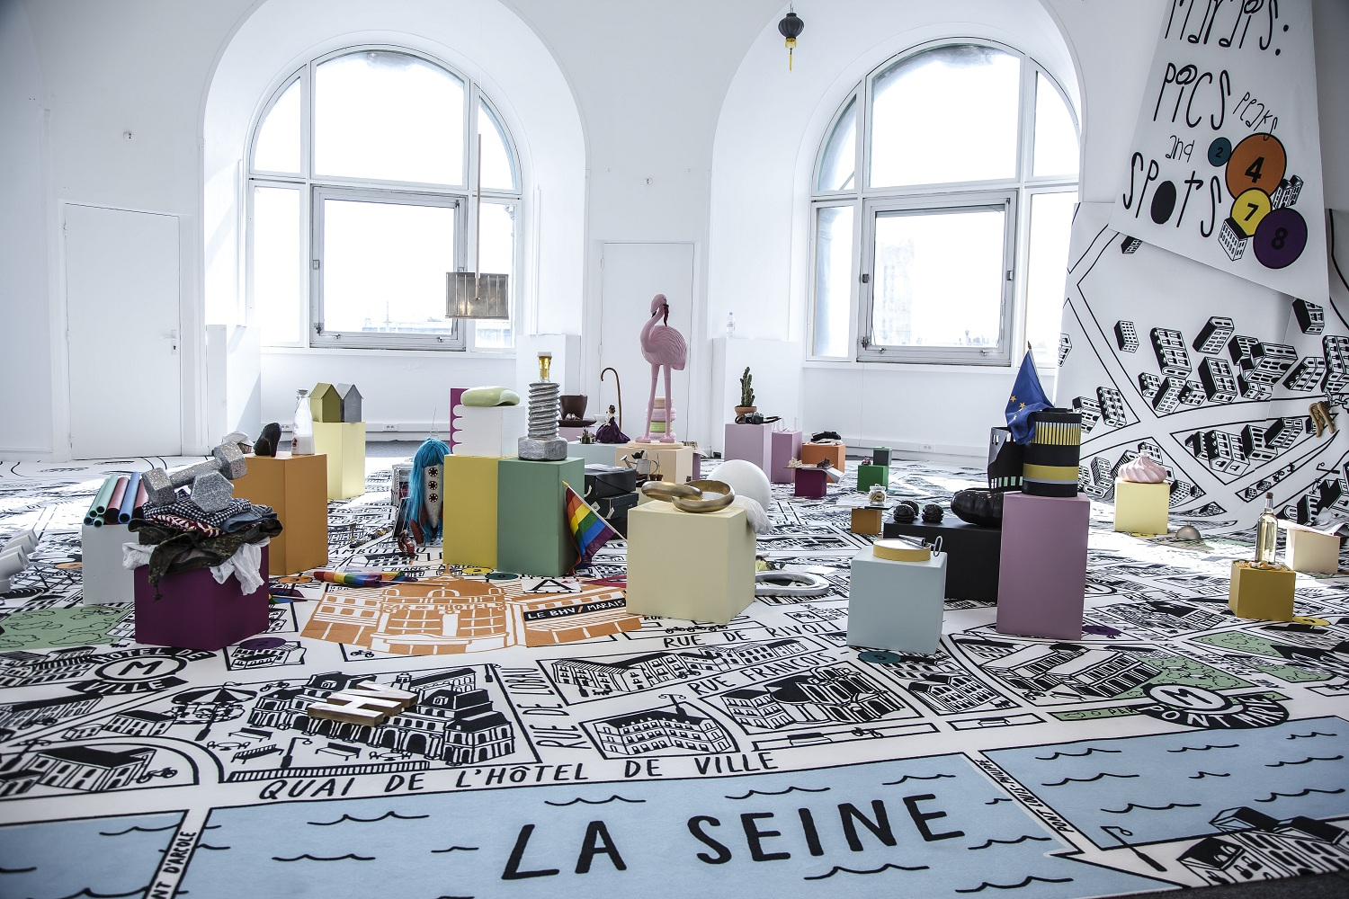
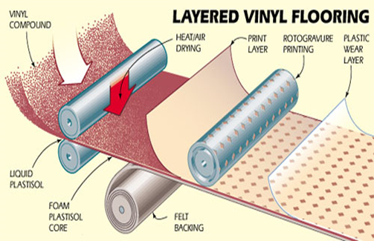
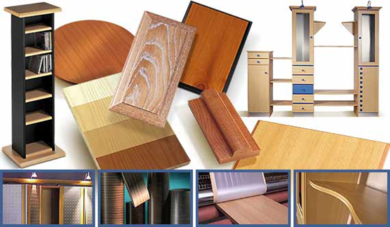
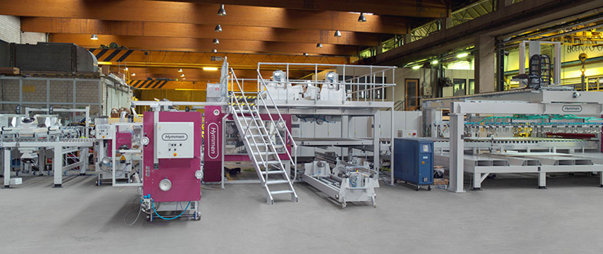
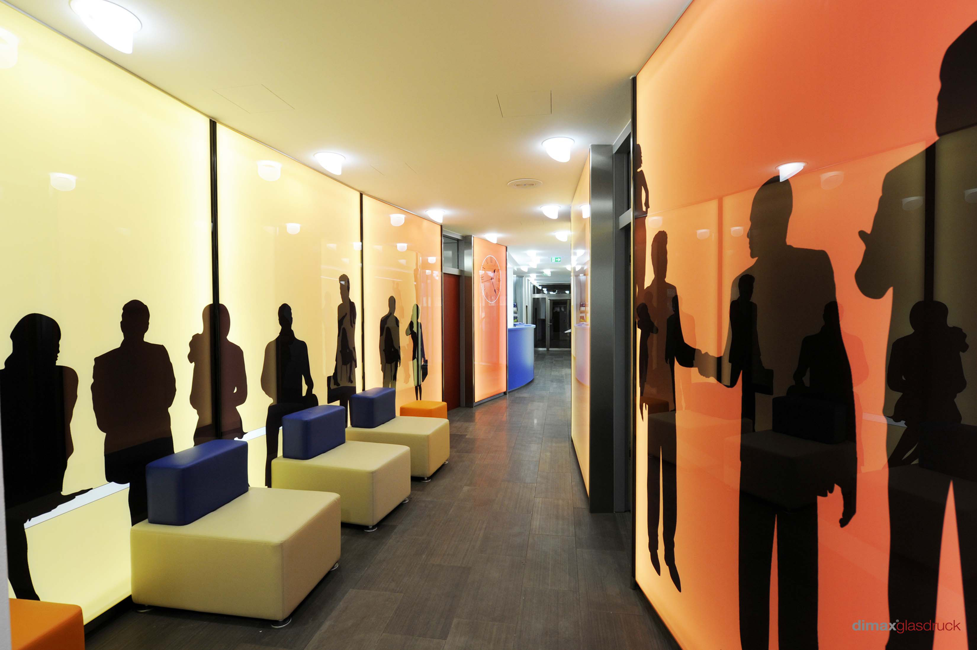
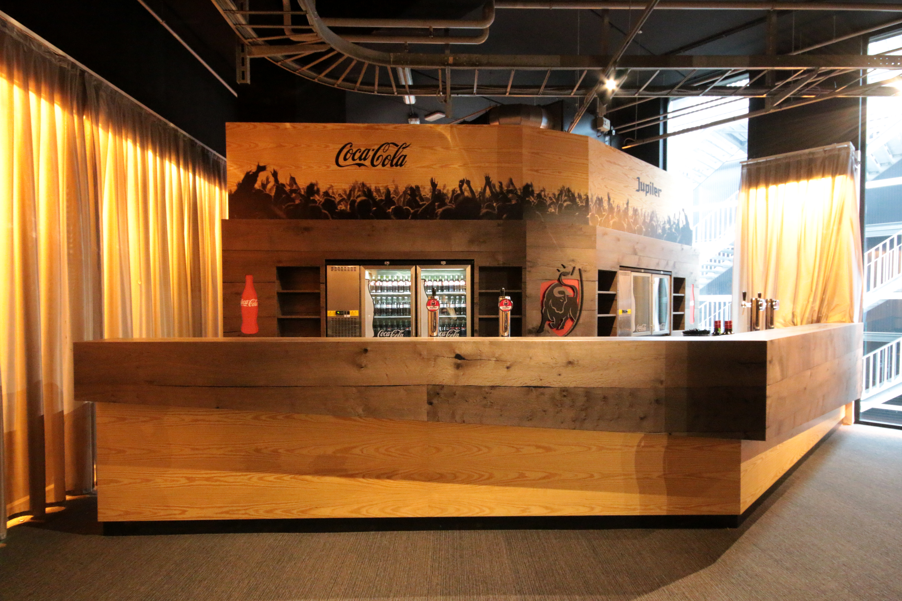
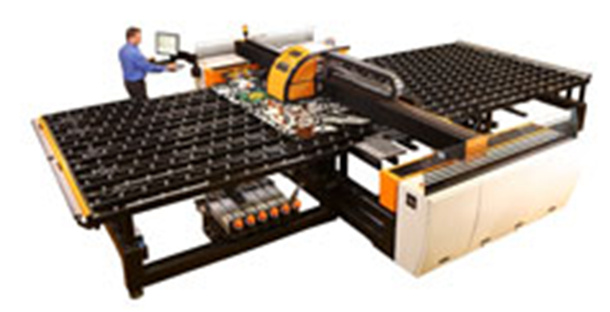
Décor & Laminates: New Frontier
technology for the production
Applications based
on wood panels
Carpet/textile & Glass applications

Slide 17
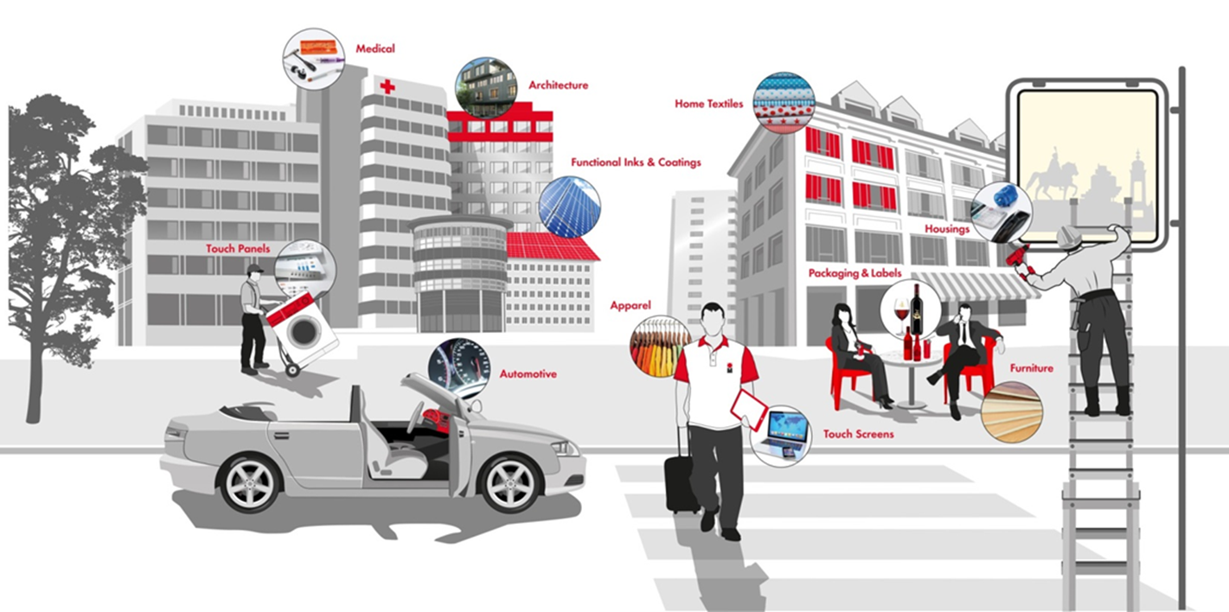
Industrial Print is everywhere!
/20
Image courtesy of Marabu

Slide 18
Conclusions of Industrial Printing:
Industrial printing is printing in the ‘Premier Legue’:
More regulations due to applications such as food, packaging, construction…
Décor & Laminates is for indoor use and direct contact
Textile used for clothing is different as soft-signage
Printing is optimising the production process = cost saving
Energy saving
Flexibility
On demand process
New possibilities (mass customisation)
/20

Slide 19
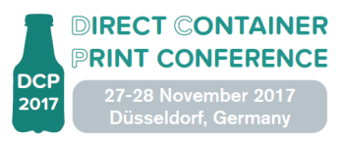
The 2017 ESMA Conferences
The Inkjet Conference, 24-25 October 2017, Neuss (Düsseldorf), Germany
World’s largest inkjet chemistry & inkjet engineering event
Direct Container Print, 27-28 November 2017, Düsseldorf, Germany
Direct to shape printing on plastics with screen and digital inkjet
GlassPrint, 29-30 November 2017, Düsseldorf, Germany
All about flat & hollow glass decoration with screen and digital inkjet
/20

Slide 20
Thank you for your Attention! Q&A And See you soon at one of our events
Peter Buttiens
pb@esma.com
+32 16 894 353
/20

